Slide 1
Q & A for Assignment 2
Xu Weiwen
wwxu@se.cuhk.edu.hk

Slide 2
Overview
Review of Assignment 2
Some Questions
Q & A

Slide 3
Review -- Environment Configuration
Windows:
VcXsrv: https://sourceforge.net/projects/vcxsrv
Putty: enable X11 forwarding
Mac
Xquartz: https://www.xquartz.org
ssh –X user@linux03.se.cuhk.edu.hk
As long as the window can be shown in your computer, it means your configuration is correct. You can ignore other warnings that may prompt in your terminal.

Slide 4
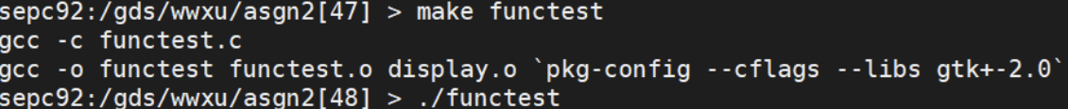
Review – Helpful Materials
Program Demo
~seem3460/distribute/asgn2_demo
Graphic functions demonstrations

Slide 5
Review – Magic Program
Part 1 -- Flow of the magic show
You are supposed to display some messages and images in the graphic window and keep flow of the magic show.
Relevant graphic functions: wait_keypress(), display_text(), display_david()
Part 2 -- Show lucky card
You are supposed to show the correct lucky card according to your favorite fruit input.
Relevant graphic functions: display_text(), move_card_set(), display_card()
Part 3 – Magic
You are supposed to design a magic show (an independent task!!) consisting of two card displays.
You should show 6 cards in the first display and 5 other cards in the second display and leave one card as hidden card.
You should follow three randomness requirements: (1) random hidden card. (2) balance colors. (3) balance letters.
You should also add relevant messages along with the card display.
Relevant graphic functions: display_card_clear(), display_text(), move_card_set(), display_card(), display_david()

Slide 6
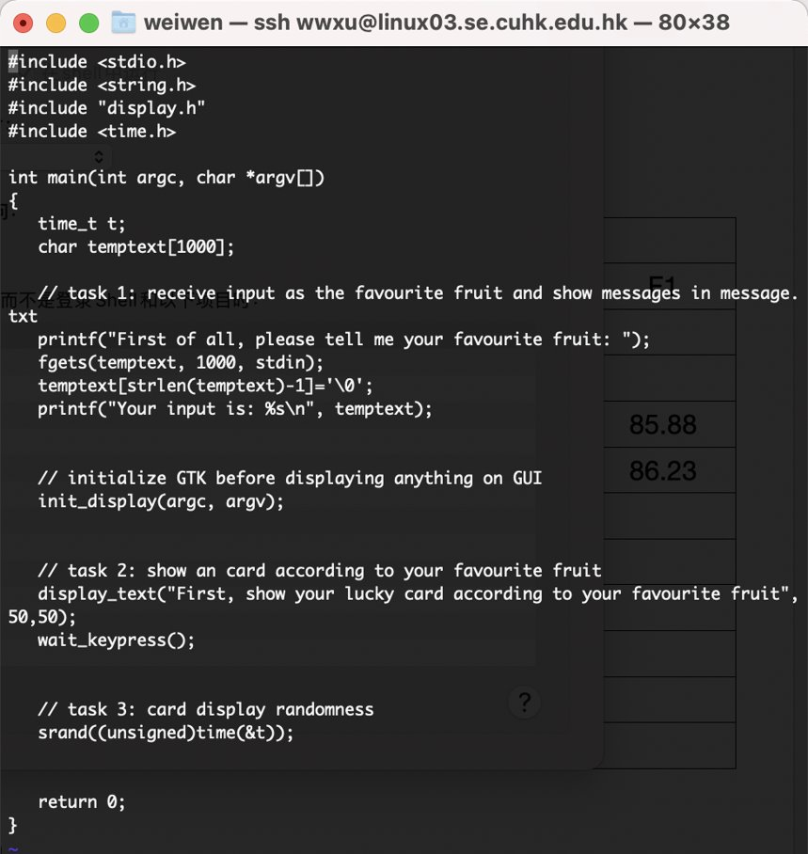
Review -- Structure
magic.c​

Slide 7
Some Questions
For the coordinates of the David photo, it is given that they are (50,150). Can I just change the coordinates as I want as long as they can be displayed?
Yes, the coordinates can be free. But make sure you can clearly show the messages and images in the window.
What does the error “Segmentation fault (core dumped)” mean when I run my program?
It means that there is logic error in your program. The reason of causing this error is the program accessing the memory not belong to it. I suggest you to run your program after some changes to see if they are valid. Otherwise, it will be hard for you to locate the error once you did many changes. (Debugging !!)
Why the UNIX shows me the error “(gedit:11304): Gtk-WARNING **: cannot open display:”?
Windows: First run VcXsrv. Then,In putty configuration, [SSH]-[X11], tick the Enable “X11 forwarding”
Mac: Add -X flag when using ssh to connect to the server

Slide 8
Question Answering
With any questions about the assignment 2, please check the following Google Doc for Q & A first and write only new questions that have not been asked before:
https://docs.google.com/document/d/1aRDeKBMyBxVub12rwdg7gK3Fxl5XEE6uqpL_ba4siFk/edit

